Slide 1
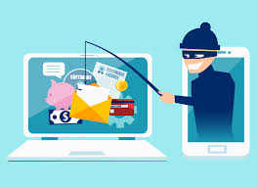
Familiarize yourself with phishing attacks HR and Marketing were the most phished out of all departments

Slide 2

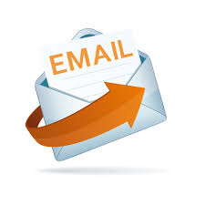
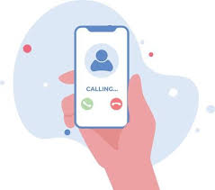
What is phishing?
Phishing is a type of cyber-crime where scammers tries to lure you into providing sensitive information such as usernames, passwords, credit card details, or other personal data. Phishing can trick through emails, and messages, that appear to be from legitimate businesses but are actually fake.
Messages Emails Phone Calls

Slide 3
Learn to spot phishing emails
1. Suspicious sender information
Check the email sender, phishing emails looks like legitimate email but slightly different such as support@mastecard.com instead support@mastercard.com
Verify caller ID , especially from banks.
2. Urgent Language
Phishing messages often urgent language to pressure you into acting quickly. For example, Your account will be suspended if you don’t act now
3. Unusual Attachment
Be very careful of unexpected attachments or links that come from unknown source
4. Spelling or Grammar mistakes
Many phishing emails or messages contain spelling errors. Professional companies always proofread before they send.

Slide 4
How do we stop getting phished?
Use security software such as malware and anti-virus as they can block suspicious activities
Enable Multi-Factor Authentication, even if attackers have your password, they still won’t access your account without the second factor such as code.
Don’t click on suspicious links
Use strong passwords
Always update your software
Report phishing attempts to your security team
User secure WI-FI

